Slide 1
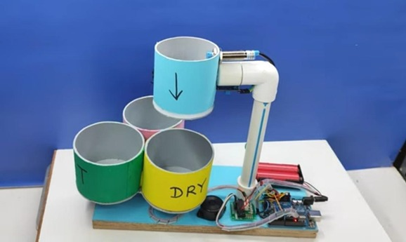

Dry, Wet, and Metal Separator
Team No: 11
Sri Sairam College Of Engineering, Bangalore-562106
Team members
Deepak M
Madan Kumar M
Problem Statement:
Automated Sorting System Using Mechatronics Principles.

Slide 2
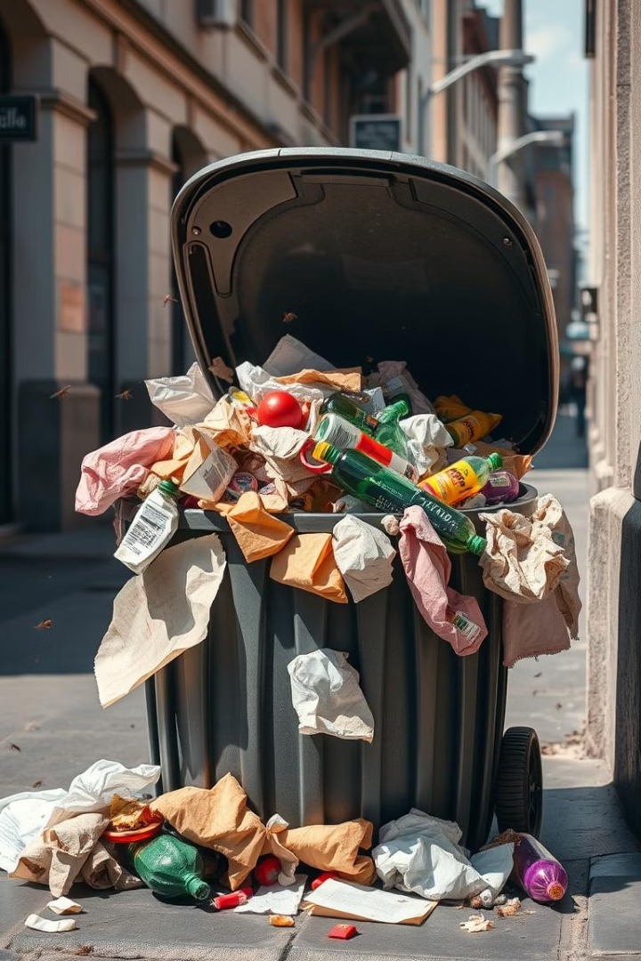
Problem: Waste Management
Inefficient Manual Sorting
Growing Waste Volume
Time-consuming, error-prone
Need for automation
Lacking Automation
Current solutions too limited

Slide 3
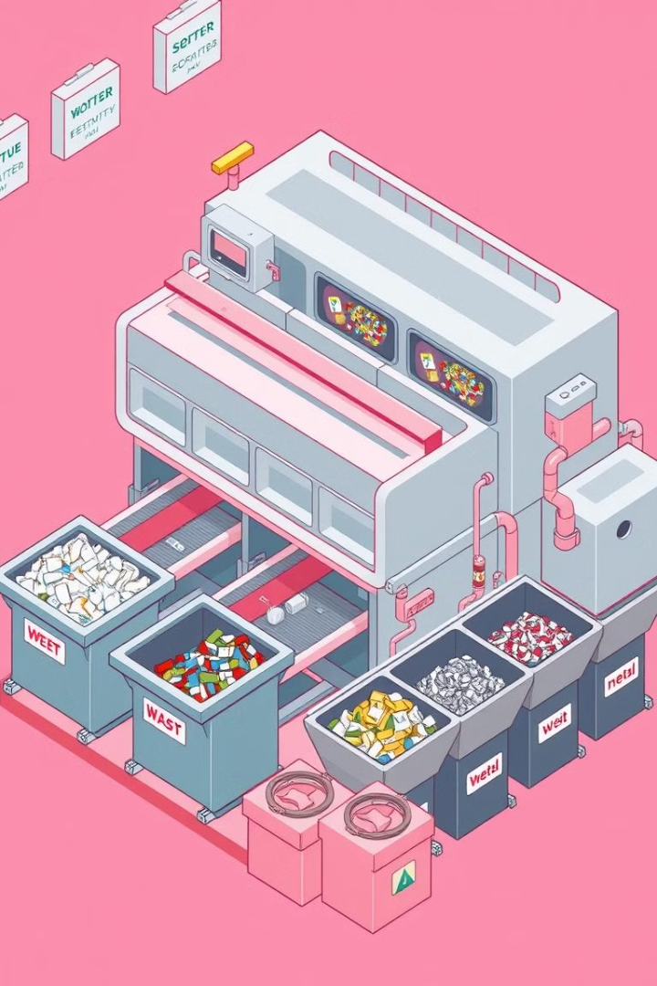



Project Overview
Waste Categories
Technology
Scalable
Dry, wet, metallic
Sensors, actuators, conveyors
Residential/Industrial

Slide 4
Key Features
Advanced Sensing
Automated Sorting
Modular Design
High Efficiency
Moisture sensors
Real-time detection
Customizable scales
Reduces labor
Metal detectors
Diversion to bins
Easy maintenance
Increases throughput
Optical sensors

Slide 5
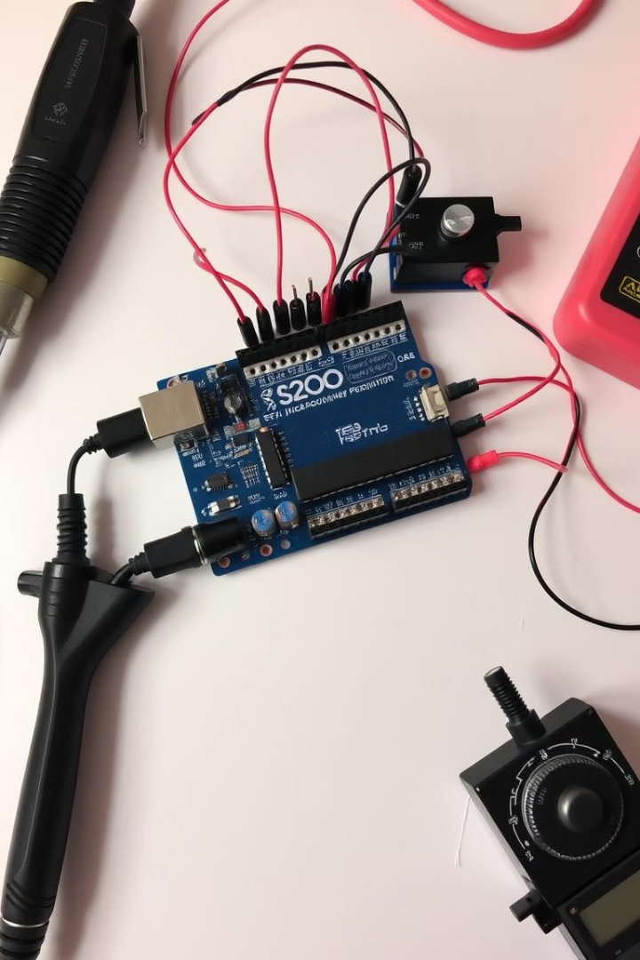




Hardware & Code
Sensors
IR, Proximity, Moisture
Actuators
Stepper, Servo motor
Alerts
Buzzer
Control
Arduino-based

Slide 6
System Workflow
Object Detected
1
Proximity sensor trigger
Presence Confirmed
2
IR sensor verification
Material Analyzed
3
Moisture/Metal Detection
Sorting
4
Bin assignment

Slide 7
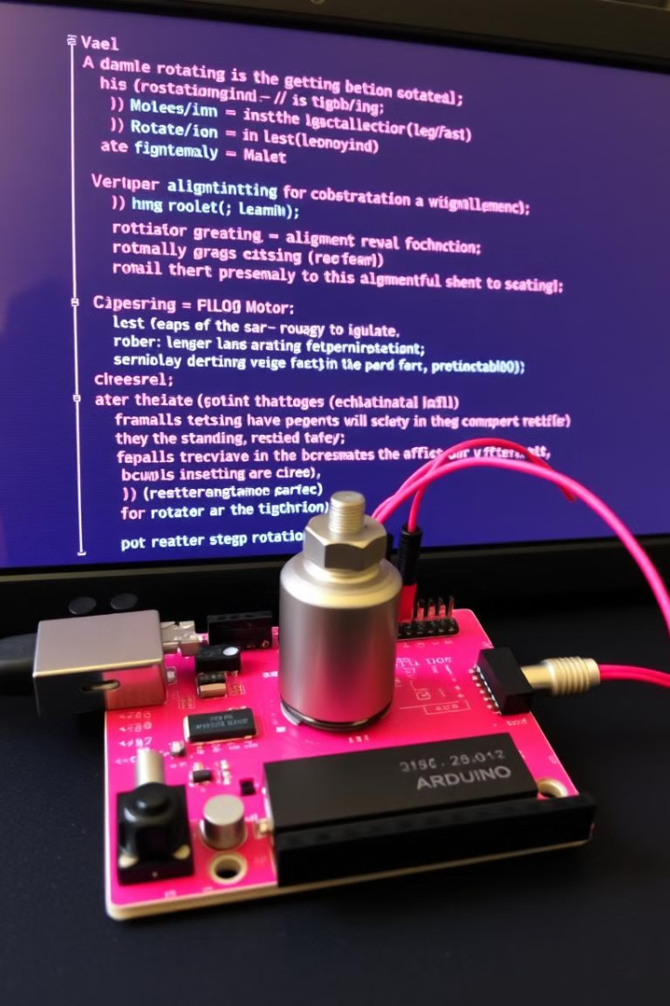
Code Logic
Stepper Motor
Object alignment
Servo Motor
Bin opening/closing
Moisture Level
Averaged Readings
Logic Branching
Dry/Wet/Metal sort

Slide 8
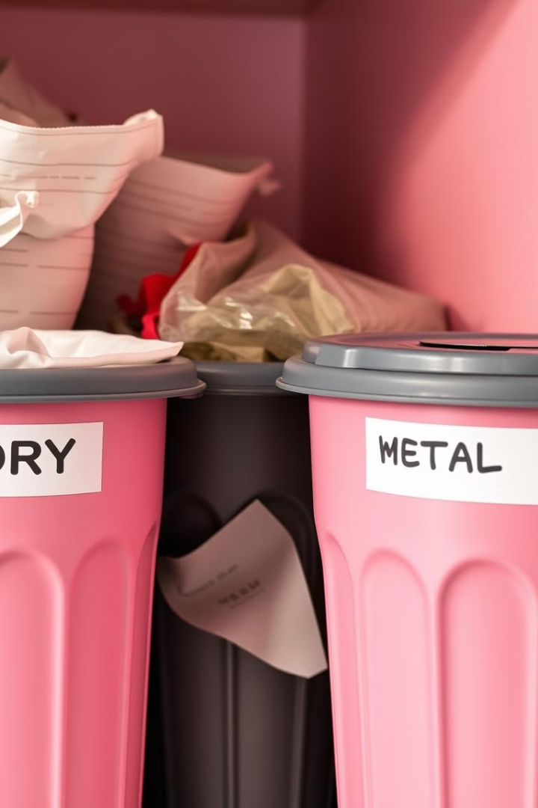
Final Output and Efficiency
95-98%
90-95%
Dry Waste
Wet Waste
Separation Accuracy
Density Separation
98%
Metal Waste
High Purity

